Slide 1

EC11: Love Actually 6th Presentation
G107 Effective Communication

Slide 2
LEARNING OUTCOMES
Identify the different types of information graphics (data diagram).
Identify and decode the embedded values and opinions in media messages.
Demonstrate and explain how different infographics can be used to encode an intended media message.

Slide 3
Problem Analysis
How do we make sense of the data?
Is there a better way to present the statistics?
What is the message conveyed by the information?
Who is our target audience and how do we reach out to them?
What is our event about?
What is our message to our target audience?
How can we encode an effective media message using the information provided??
Key:

Slide 4
Part 1: Information graphics

Slide 5
What are Information Graphics?
Also known as infographics
It is any graphic that clarifies and/or explains.
This includes data diagrams (e.g. bar charts, pie charts, fever charts, etc.) and text-based graphics (e.g. tables, time-lines, etc.)

Slide 6

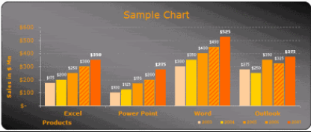
Basic Data Diagrams
BAR CHART
Are used to compare data using rectangular like bars to represent amounts within a data set.
These types of charts make comparisons between different variables easy to see.

Slide 7
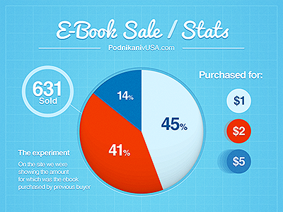
Basic Data Diagrams
PIE CHART
Used to represent different parts of a whole.
Should be presented in percentages adding up to 100%.

Slide 8
Basic Data Diagrams
FEVER CHART (LINE GRAPH)
Compare two related variables, plotted along an x and a y-axis.
Great for showing specific values of data, especially when the nature of one variable is directly related to another.
Example: showing trends / changes over time

Slide 9

Text-based Graphic
TABLES
Helps to categorise data and structure information visually.
Compare two or more components

Slide 10
Part 2: media literacy

Slide 11

What is Media Literacy?
It is the ability
to assess, analyse, evaluate, and create media.
to understand the complex messages we receive from television, radio, Internet, newspapers, magazines, books, advertisements, video games, music, and all other forms of media.

Slide 12
Key Concepts of Media Literacy
Media are constructions
Audience negotiate meaning
Media have commercial implications
Media have social and political implications
Each medium has a unique aesthetic form
Media messages contain “texts” and “subtexts”

Slide 13
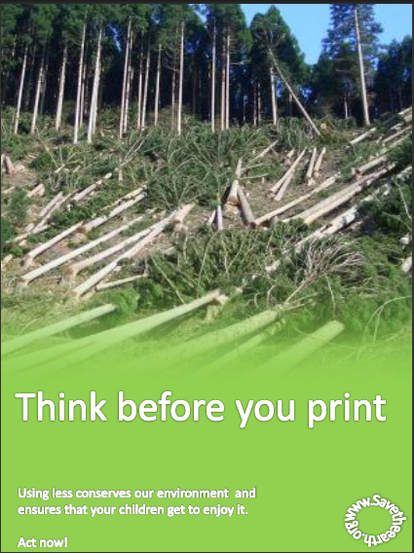
Components of a Media Message
Text: What is actually shown in the message?
Picture of trees cut down,
The slogan ‘Think before you print’.
Subtext: Your interpretation of the message.
Printing less means that less paper is used and trees are saved.
Deforestation destroys the environment.

Slide 14

An ad for Crisis Relief
Notes:
Image from:
Creative ideas celebrated at Busan Ads Festival. (2013, August 30). Retrieved September 30, 2015, from http://www.korea.net/NewsFocus/Society/view?articleId=111973

Slide 15
Text:
The image a woman holding on to a child who is hurt or dying.
The image of hands with thumbs-up surrounding the woman and child.
The slogan “Liking isn’t helping”
The words “Be a volunteer. Change a life” at the bottom of the poster.
The logo of Crisis Relief at the bottom of the poster.

Slide 16
Subtext:
The woman and child are from a war torn country.
The hands with thumbs up represent users of social media.
Clicking the “Like” button on social media does not resolve a crisis. Volunteering is a more practical way to help.
One should extend a helping hand instead of extending a “thumbs up”

Slide 17
Who is media literate?
A digital and media literate person is someone who is able to:
Critically evaluate and interpret information on media platforms, both online and offline.
Make wise choices about the information they create, post and share online.
Take responsibility for their actions and show good judgement in their online interactions
Recognize the online risks and take appropriate action to protect self and others

Slide 18
Why be media literate?
We live in a media-filled environment. We are bombarded with media messages all day, every day.
We need to be able to tell the difference between what is said and what is not said.
It helps us to understand communication platforms and how they can be used and manipulated.
Being media literate is part of being an informed and educated citizen.

Slide 19
Media Literacy and the Communication Model
Context
Encode
text
subtext
persuasive
appeals
and ploys
Message
(with
Embedded
values and
Opinions)
Decode
(audience
Interpretation)
Sender
Receiver
Culture
Culture
What Is Not Stated

Slide 20
Part 3: infographics + media literacy

Slide 21
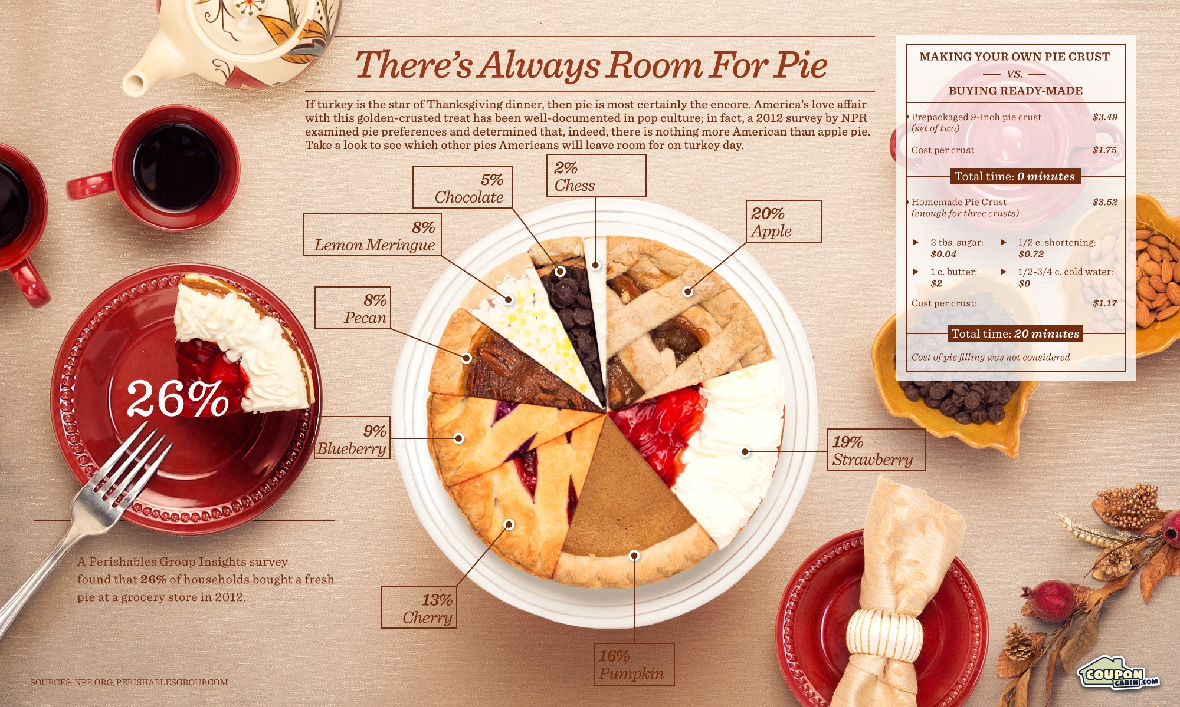

Slide 22

Text:
The caption “There’s always room for pie.”
The image of slices of pies on a plate.
A pie chart showing the different pie flavours and the percentage of American’s preferences for the flavours
The image of tea, teacups, and a napkin.
Notes:
Image from:
There's Always Room for Pie. (n.d.). Retrieved September 30, 2015, from http://visual.ly/theres-always-room-pie

Slide 23
Subtext:
Americans love to eat pie.
There are many pie flavours found in America.
Apple and strawberry pies are the most popular in America
One should drink tea when eating pie.

Slide 24
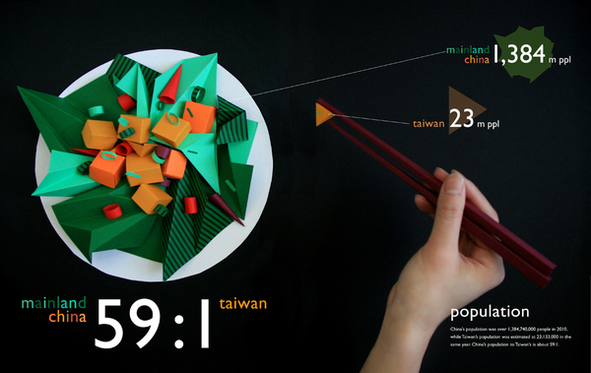
Notes:
Image from:
Liao, T. (n.d.). Ilha Formosa. Retrieved September 30, 2015, from http://www.tienminliao.com/ilha-formosa

Slide 25
Text:
The population ratio of China to Taiwan is 59:1
China has a population of 1,384 million. Taiwan has a population of 23 million.
The word “population” at the lower right hand corner of the infographic.
The image of a hand holding a pair of chopsticks, and picking out “food” from the plate.
The image of a plate with food made up of origami.
Notes:
Image from:
Liao, T. (n.d.). Ilha Formosa. Retrieved September 30, 2015, from http://www.tienminliao.com/ilha-formosa

Slide 26
Subtext:
China is a much larger country than Taiwan.
If China’s population is the whole dish, Taiwan’s population is a small portion of the dish.
China and Taiwan shares similar culture (e.g., the use of chopsticks)
Notes:
Image from:
Liao, T. (n.d.). Ilha Formosa. Retrieved September 30, 2015, from http://www.tienminliao.com/ilha-formosa

Slide 27
APPLICATION TO THE PROBLEM

Slide 28
Data set A
Survey question (to all): “How do you know if you’ve got a successful date?”
45% indicated ‘having a good conversation’
25% mentioned ‘having lots of laughing’
18% indicated ‘can’t keep your eyes off each other’
7% said ‘physical attraction’
5% mentioned ‘having similar tastes’

Slide 29
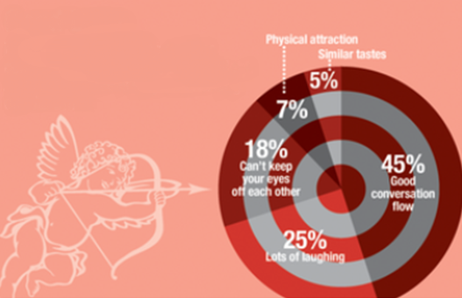
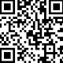
Poster 1a (Data Set A)
Text (words): The slogans “Perfect Date” & “Perfect Conversations”
Subtext: The opportunity to start perfect conversations increases the chances to find the perfect valentine!
Text (Image): The cupid & target board
Subtext: The cupid creates the perfect match by ‘hitting the bull’s eye’. (The use of the cupid and target board is consistent with the slogans.)
Perfect Date
Infographic – The pie chart is appropriately chosen to illustrate the statistics (the many parts of a whole), with the majority (45%) of the people surveyed indicating good dates as having good conversations.
Persuasion Appeals:
-The use of infographics/statistics increases the logos/logical appeal.
-The cupid evokes feelings of romantic love and enhances the pathos/emotional appeal.
-Websites addresses, company logos increase credibility and strengthens the ethos appeal.
Perfect Conversations
Join us for a memorable lunch date this weekend at Fort Canning for some deep, meaningful conversations!
Scan the QR Code for more information.
Visit www.loveactually.com.sg
Love Actually

Slide 30
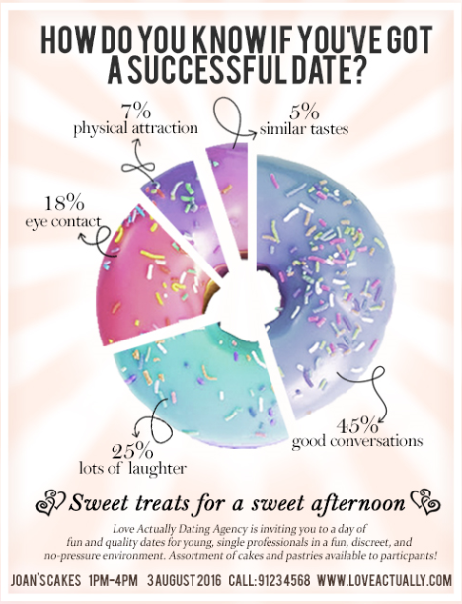
Poster 1b (Data Set A)
Text: “How do you know you’ve got a successful date?” and “Sweet treats for a sweet afternoon”
Subtext: “Love is sweet. We will find you find love” (The use of the image is consistent with the text above.)
Infographic – The pie chart is used appropriately and accurately to illustrate the statistics given.
Persuasion Appeals:
- The use of infographics/statistics increases the logos/logical appeal.
- Websites addresses, company logos increase credibility and strengthens the ethos appeal.
Credit: Poster done by students from G107 AY2016 Semester 1.

Slide 31
Data set B
Survey question (to men): “How long do you spend planning for a date?”
14% indicated 0-30 minutes
48% indicated 31-60 minutes
26% indicated 61-120 minutes
12% indicated more than 120 minutes

Slide 32
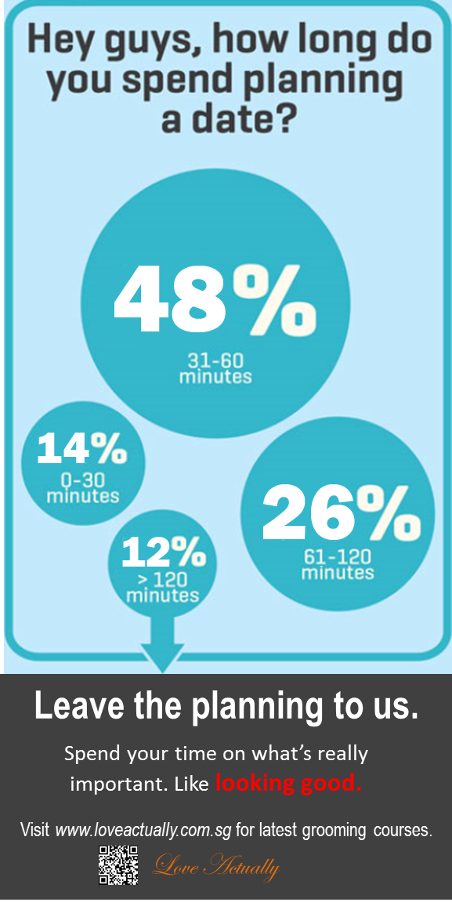
Poster 2 (Data Set B)
Text (words): “Hey guys, how long do you spend planning a date – leave the planning to us.“
Subtext: Planning for a date can be a tedious chore! You can leave that to the professionals, while you take care of the more important things - like making sure you look good and meet your dream date!
Infographic – The text-based graphic is used appropriately and accurately to illustrate the statistics given.
Persuasion Appeals:
- The use of infographics/statistics increases the logos/logical appeal.
-Websites addresses, company logos increase credibility and strengthens the ethos appeal.
COME TO OUR LUNCH EVENT!

Slide 33
Data set C
Survey question (to women): “How do you like to be contacted by a guy you just met?”
18% prefer a call
74% prefer a text to start things off
6% would like to be contacted on Facebook
2% prefer to be contacted through a mutual friend.

Slide 34


Poster 3a (Data Set C)
Text Me, Maybe?
Text (words): “Text Me, Maybe?”, and “The 5 first Dates Do’s and Don’ts for Men and Women”.
Subtext: Need help to jumpstart your first date? The professionals are here to help you get started. Attend the workshop now!
Most women surveyed prefer being contacted by a text message for the first date.
Infographic – The bar chart is used appropriately and accurately to illustrate the statistics given.
Text (Image): A man and woman smiling and toasting to wine.
Subtext: The man and woman are feeling happy and enjoying their first date. (The use of the image is consistent with the text above.)
Join us for a fun-filled afternoon to find out the
5 First Dates Do’s and Don’ts for
Men & Women.
Persuasion Appeals:
- The use of infographics/statistics increases the logos/logical appeal.
- Websites addresses, company logos increase credibility and strengthens the ethos appeal.
For workshop details, visit www.loveactually.com..sg or scan the QR code.
Brought to your lovingly by Love Actually

Slide 35
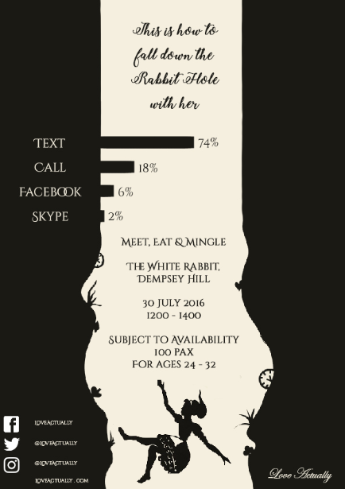
Poster 3b (Data Set C)
Text: “This is how to fall down the rabbit hole with her”
Subtext: “Find the perfect one and fall deeply in love with her.” (The use of the image is consistent with the text above.)
Infographic – The bar chart is used appropriately and accurately to illustrate the statistics given.
Persuasion Appeals:
- The use of infographics/statistics increases the logos/logical appeal.
- Websites addresses, company logos increase credibility and strengthens the ethos appeal.
Credit: Poster done by students from G107 AY2016 Semester 1.

Slide 36
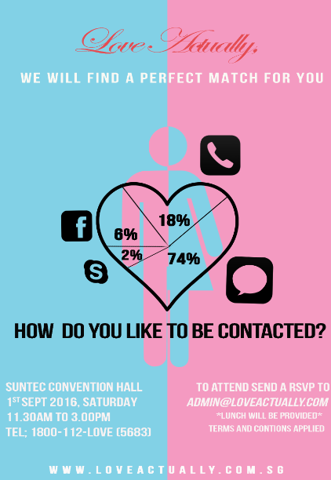
Poster 3c (Data Set C)
Text: “How do you like to be contacted? We will find a perfect match for you”
Subtext: “We will help you find love” (The use of the image is consistent with the text above.)
Infographic – The ‘loose’ pie chart is used appropriately and accurately to illustrate the statistics given.
Persuasion Appeals:
- The use of infographics/statistics increases the logos/logical appeal.
- Websites addresses, company logos increase credibility and strengthens the ethos appeal.
Credit: Poster done by students from G107 AY2016 Semester 1.

Slide 37

Extended Learning
Watch the video below to see how infographics can affect the media message.
Source:The Girl Effect – The Clock is Ticking (2011, August 22). Retrieved from VideoInfographics website, http://www.videoinfographics.com/the-girl-effect-the-clock-is-ticking/

Slide 38
CONCEPT DIAGRAM
Infographics
-Tables
-Bar Graph
-Pie Graph
-Line Graph
Media Literacy
-Text
-Subtext
Decode + Encode a Media Message

Slide 39
References
Infographics
George-Palilonis, J. (2006). A Practical Guide to Graphics Reporting (pp. 9-14,125-140). Oxford UK: Focal Press.
Lipton, R. (2007). The Practical Guide to Information Design. (pp. 179-191). New Jersey USA: John Wiley & Sons Inc.
Slobin, S. (2010, March 25). The 7 ½ Steps to Successful Infographics. Retrieved from http://visitmix.com/Articles/seven-and-a-half-steps-to-successful-infographics

Slide 40
References
Media Literacy
An Introduction to Media Literacy. (n.d.). Retrieved December 31, 2017 from Media Literacy Project website, http://medialiteracyproject.org/
Media Literacy Fundamentals (n.d.). Retrieved December 31, 2017 from Media Smarts -Canada’s Centre for Digital and Media Literacy website, http://mediasmarts.ca/digital-media-literacy-fundamentals/media-literacy-fundamentals
Media and Digital Literacy. (n.d.). Retrieved December 31, 2017 from Media Literacy Council website, http://www.medialiteracycouncil.sg/media-and-internet/Pages/media-and-digital-literacy.aspx

